Slide 1


Reactive Programming

Slide 2

Reactive Programming?
Reactive Programming is design pattern that focuses on use of asynchronous and non-blocking data streams to handle data and events.
Help us to increase Efficiency and Scalability of applications.

Slide 3
Synchronous and Blocking
30 min(wait)
Thread1
Client
Thread2
Thread3

Slide 4
Asynchronous and Non-Blocking
30 min(wait)
Thread1
Client
Request1
After 30 min
Request2
Response

Slide 5
Features of Reactive Programming
Asynchronous and non-blocking
Functional Style coding
Data flow as event driven
Backpressure of DataStream

Slide 6
Reactive Stream Specification
Reactive programming has some rules these rules is known as Specification
There are 4 main interfaces
Publisher
Subscriber
Subscription
Processor

Slide 7
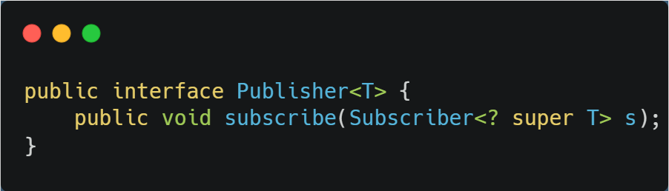
Publisher
Act as data source.

Slide 8
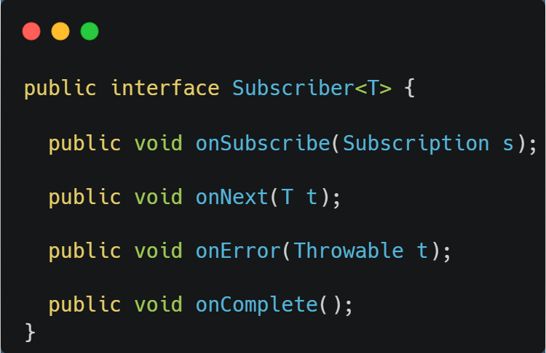
Subscriber
Act as data receiver.

Slide 9
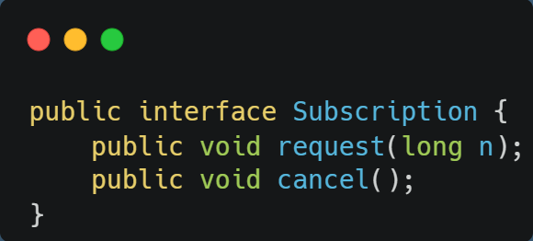
Subscription
Request data from Publisher or cancel a request.

Slide 10
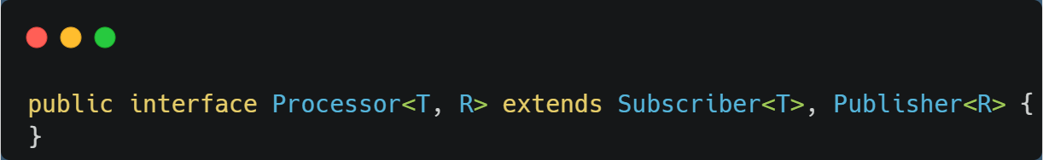
Processor
Processor interface is the combination of both Publisher and Subscriber interfaces.

Slide 11
Pub Sub Event Flow
Publisher
onComplete()
Subscriber
……n…
onNext(data)
onNext(data)
request(n)
onSubscribe(Subscription s)
subscribe(Subscriber r)

